Slide 1

Alloy Modelling Language

Slide 2
Download org.alloytools.alloy.dist.jar file

Slide 3
Introduction
Software involves structures of many sorts:
architectures,
database schemas,
network topologies,
ontologies,
and so on.
When designing a software system, you need to be able to express the structures essential to the design and to check that they have the properties you expect.
You can express a structure by sketching it on a napkin. That's a good start, but it's limited.
Informal representations give inconsistent interpretations, and they cannot be analyzed mechanically.
So, people have turned to formal notations that define structure and behavior precisely and objectively, and that can exploit the power of computation.

Slide 4
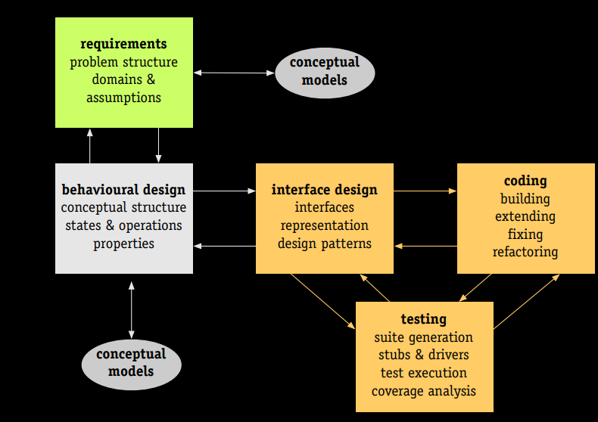

Slide 5
Conceptual Modeling
What is it?
Capture requirements, other essential aspects of software
Abstract out inessential details
Analyze model
Identify high-level errors at analysis time itself, rather than after coding
Kinds of conceptual models
Class diagrams
State machines
Logics (propositional, predicate, Hoare)
Algebras (Relational, real numbers, etc.)

Slide 6
Alloy
Alloy is a formal modeling language aimed at expressing structural and behavioral properties of software systems
Alloy has formal syntax and semantics
There is also a visual representation (similar to UML class diagrams and entity-relationship diagrams) but the visual representation does not have the expressiveness of the whole language
Alloy has a verification tool called Alloy Analyzer which can be used to automatically analyze properties of Alloy models

Slide 7
Alloy
Formal modeling of entities and associations, using sets and relations
In Alloy, everything is a set and those sets are built from atoms and relations
An atom is a primitive entity that is indivisible, immutable, uninterpreted (it does not have any built-in property)
A relation is a structure that relates atoms.
It is a set of tuples, each tuple being a sequence of atoms
Modeling of invariants/constraints on the relationships
Analyzing the model, and identifying whether
it is under-constrained (i.e., allows erroneous relationships),
or over-constrained (i.e., disallows required relationships)

Slide 8
Signatures
Entities are represented using Signatures in Alloy
Describe classes of entities we want to reason about
For Example, for a school management system entities will be: Student, Teacher, Subject, etc.
Syntax:
sig Student{}
sig Teacher{}
sig Subject{}

Slide 9




Signatures
Alloy can generate models that have elements of each signature, called atoms. Following are some of the models generated by Alloy
Model 1 – Student= {Student0, Student1}, Teacher={Teacher0, Teacher1}, Subject={Subject}
Model 2 – Student= {Student}, Teacher={Teacher0, Teacher1, Teacher2}, Subject={Subject}
Model 3 – Student= {Student0, Student1}, Teacher={}, Subject={}
Model 4 – Student= {Student}, Teacher={Teacher}, Subject={}
Atom

Slide 10
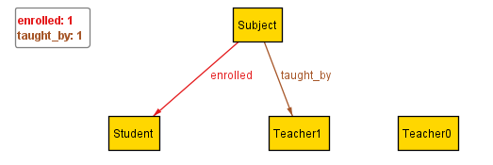
Relations - Fields
Usually, we care about the relationships between the parts of our systems.
We don’t just care that there are students, teachers and subjects, we care which students are enrolled in what subjects, which subject is taught by whom, etc.
We do this by adding relations inside of the signature body. These are called Fields.
The body of a signature is a list of relations, which show how the signatures are connected to each other.
Relations are separated by a comma. The list can also start and end with a comma. Relations do not have to be on separate lines, as long as they are separated by commas.
Continuing the example:
sig Student{}
sig Teacher{}
sig Subject{
taught_by: Teacher,
enrolled: Student,
}
One of the models generated by Alloy
Subject={Subject}, Student={Student}, Teacher={Teacher1, Teacher2}
taught_by = {(Subject, Teacher1)}, enrolled={(Subject, Student)}
Atom
Tuple

Slide 11
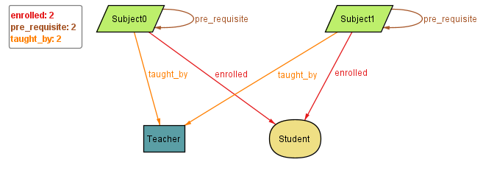
Relation - Fields
Relations can refer to the same signature.
For Example:
sig Student{}
sig Teacher{}
sig Subject{
taught_by: Teacher,
enrolled: Student,
pre_requisite: Subject
}
One of the models generated:
Subject={Subject0, Subject1}, Student={Student}, Teacher={Teacher}
taught_by = {(Subject0, Teacher), (Subject1,Teacher)}, enrolled={(Subject0, Student), (Subject1, Student)}, pre_requisite={(Subject0,Subject0), (Subject1,Subject1)}
Alloy can generate models where a relation points from an atom to itself, aka a “self-loop”.
For this reason we often want to add constraints to our model, such as Facts or Predicates.

Slide 12
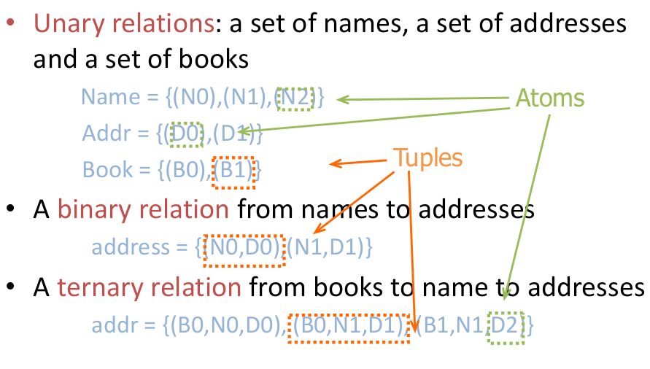
Atoms & Relations
Size of a relation: the number of tuples in the relation
Arity of a relation: the number of atoms in each tuple of the relation
Relations with arity 1, 2, and 3 are said to be unary, binary, and ternary relations respectively
Examples.
relation of arity 1 and size 1
myName = {(N0)}
relation of arity 2 and size 3
address = {(N0,D0),(N1,D1),(N2,D1))

Slide 13
Field Expressions
A field can be a simple expression over other signatures.
sig Resource {
permissions: (User + Group)
}
In addition to full signatures, the expression may contain this, which refers to the specific atom itself.
sig Node {
-- no self loops
, edges: Node – this
}
A dependent field is one where the expression depends on the values of other fields in the atom. The dependencies must be fields defined either in the signature or its supertype.
sig Item {}
sig Person {
, favorite: Item
, second: Item - favorite
}

Slide 14
Continuing Academia Example
Removing Self loop
sig Student{}
sig Teacher{}
sig Subject{
taught_by: Teacher,
enrolled: Student,
pre_requisite: Subject - this
}

Slide 15
Multi-relations
Signatures can have multi-relations as fields:
sig Door {}
sig Card {}
sig Person {
access: Card -> Door
}
In this case access is a ternary relationship, where each element of access is a relation of form
Person -> Card -> Door.
access = {(Person0,Card1,Door1), (Person1,Card0, Door0)}

Slide 16
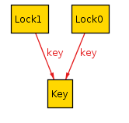
Multiplicity - one
Each relation has a multiplicity, which represents how many atoms it can include. If you do not include a multiplicity, it’s assumed to be one.
one
The default.
r: one A states that there is exactly one A in the set.
sig Key {}
sig Lock { key: one Key }
This says that every lock has exactly one Key. This does not guarantee a 1-1 correspondence! Two locks can share the same key.
If no multiplicity is listed, Alloy assumes to be one. So, the above relation can also be written as key: Key.

Slide 17
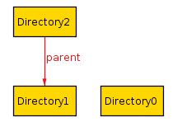
Multiplicity - lone
lone
r: lone A
states that either there is one A in the set, or that the set is empty. You can also think of it as “optional”.
Example:
sig Directory {
parent: lone Directory
}
This says that every directory either has one parent, or it does not have a parent (it’s a root directory).

Slide 18
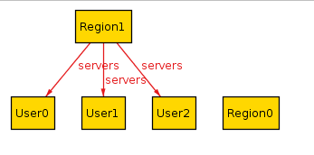
Multiplicity - set
set
r: set A
states that there can be any number of A in the relation.
Example:
sig User {}
sig Region {
servers: set User
}

Slide 19
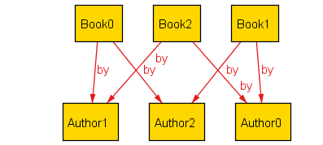
Multiplicity - some
some
r: some A
states that there is at least one A in the relation.
Example:
sig Author {}
sig Book {
by: some Author
}

Slide 20
Multiplicity - disj
disj
disj can be prepended to any multiplicity to guarantee that it will be disjoint among all atoms. If we write
sig Lock {}
sig Key {
lock: disj one Lock
}
Then every key will correspond to a different lock. If we instead write
sig Lock {}
sig Key {
locks: disj some Lock
}
Then every key will correspond to one or more locks, but no two keys will share a lock.

Slide 21
Signature Multiplicity
In addition to having multiplicity relationships, we can put multiplicities on the signatures themselves.
one sig Foo {}
some sig Bar {}
//etc
By default, signatures have multiplicity set, and there may be zero or more in the model.
By making the signature one, every model will have exactly one atom of that signature.
By writing some, there will be at least one.
By writing lone, there will be zero or one.

Slide 22
Multiplicity in Multi-relations
Multirelations have a special kind of multiplicity:
r: A m -> n B
This says that each member of A is mapped to n elements of B, and m elements of A map to each element of B. If not specified, the multiplicities are assumed to be set.

Slide 23
r: A m -> n B
m | n | Meaning
set | set | No restrictions
set | some | Each A used at least once
set | one | Each A is mapped to exactly one B (total function)
set | lone | Each A is mapped to at most one B (partial function)
some | set | Each B mapped to at least once
some | some | Every A mapped from and every B mapped to
some | one | Each A used exactly once, each B used at least once
some | lone | Each A used at most once, each B used at least once
one | set | Each B used exactly once, no other restrictions (one A can map to two B atoms)
one | some | Each B used exactly once, each A used at least once
one | one | Only satisfiable if #A = #B, bijection
one | lone | At most #A arrows, exactly #B arrows, each A used at most once
lone | set | Each B used at most once
lone | some | Each A used at least once and each B used at most once
lone | one | Each A used exactly once, each B used at most once
lone | lone | Each A used at most once, each B used at most once

Slide 24
Continuing Academia Example
Adding multiplicity constraints
module tour/schoolmgmt
sig Student{}
some sig Teacher{}
some sig Subject{
taught_by: one Teacher,
enrolled: some Student,
pre_requisite: set Subject- this
}
pred show() {}
run show for 3 but 2 Teacher

Slide 25
Subtypes
We can make some signatures subtypes of other signatures.
In
Creates inclusive subsets
Writing sig Child in Parent creates Child set a subset of Parent.
Example:
sig Machine {}
sig Broken in Machine {}
sig Online in Machine {}
In this case, Broken and online are subsets of Machines.
Any Machine can be Broken, Online, both, or neither.

Slide 26
Subtypes
extends
Creates disjoint subsets
Example:
sig Machine {}
sig Client extends Machine {}
sig Server extends Machine {}
In this case, any Machine can be a Server, a Client, or neither, but not both.

Slide 27
Abstract supertype
abstract
If you make a signature abstract, then all atoms of the signature will belong to extensions.
There will be no atoms that are just the supertype and not any of the subtypes.
Example
abstract sig Machine {}
sig Broken in Machine {}
sig Server extends Machine {}
sig Client extends Machine {}
Here any machine must be either a Server or a Client. They still may or may not be Broken.

Slide 28
